Slide 1

World Population
Prediction
Done By:
A.Thrishal Reddy
(2203A52131)
CSE-AIML(AA)
Trainer:
Mr. D.Ramesh
Asst. Professor
CS & AIML

Slide 2

Introduction
Global population is an important topic for understanding the future of humanity. This presentation explores how machine learning can be used to predict population trends. We will focus on two popular algorithms: Linear Regression and Support Vector Machines (SVM).

Slide 3

Population Growth
The world's population is expected to reach 9.7 billion by 2050. This growth presents challenges for food security, resource management, and social stability. Machine learning can help us better understand and plan for these changes.

Slide 4
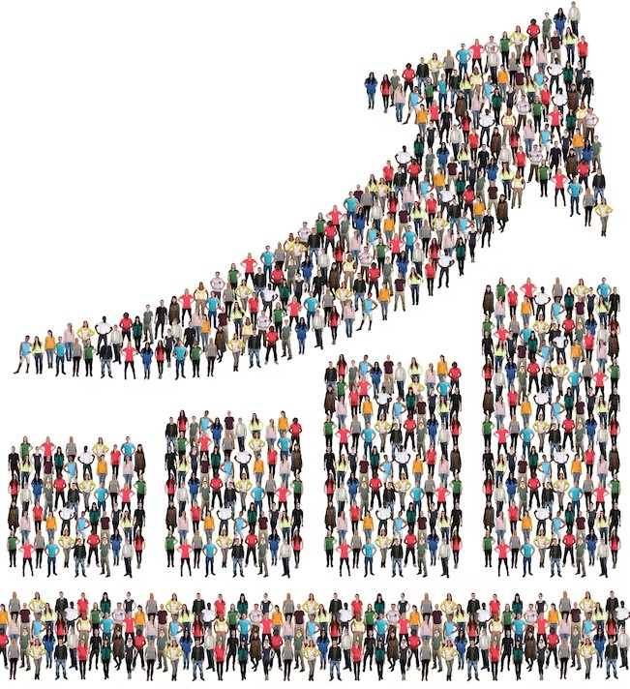
Linear Regression
Linear Regression is a statistical method for modeling the relationship between two variables. In population studies, it can be used to predict future population growth based on historical data. This method assumes a linear relationship between the variables.

Slide 5

Support Vector Machine
Support Vector Machines (SVM) is a machine learning algorithm that can be used for classiﬁcation and regression analysis. In population studies, it can be used to predict future population growth based on historical data. This method can handle non-linear relationships between variables.

Slide 6
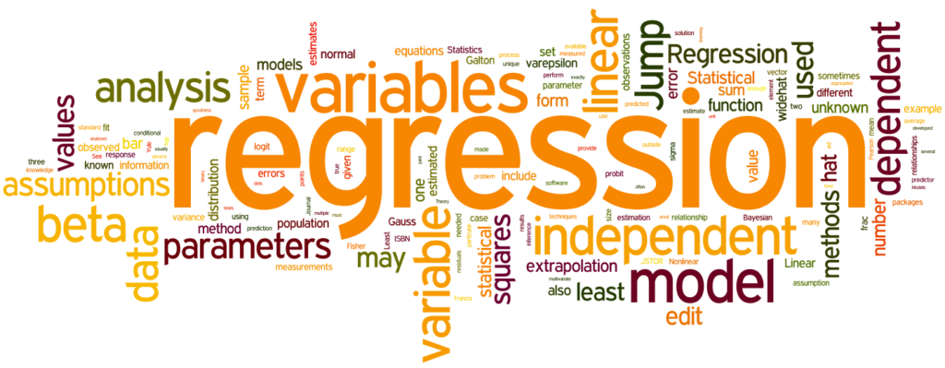
Lasso regression
Lasso Regression is a linear regression technique that adds a penalty term to the cost function, encouraging the model to select a subset of the most important features for prediction, effectively performing feature selection.

Slide 7
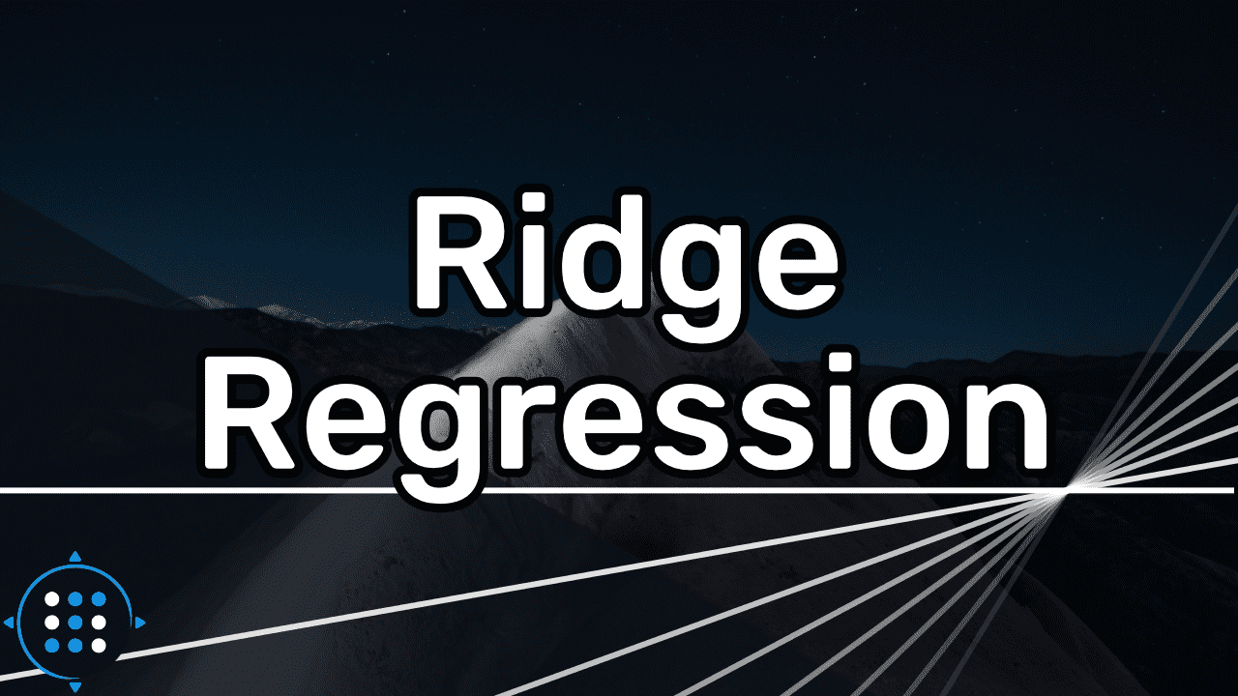
Ridge regression
Ridge Regression, also a linear regression method, includes a regularization term in the cost function to prevent overfitting by reducing the magnitude of the model's coefficients. It's particularly useful when dealing with multicollinearity among predictors.

Slide 8
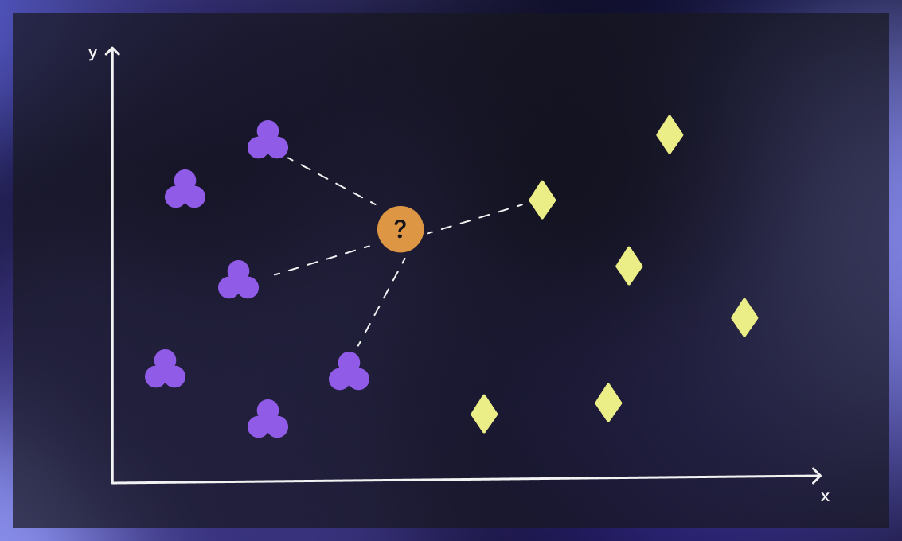
K-nearest neighbour
K-Nearest Neighbors (KNN) is a non-parametric, instance-based algorithm used for classification and regression tasks. It makes predictions based on the majority class or average of the k-nearest data points in the feature space, making it robust for various data distributions and non-linear relationships

Slide 9
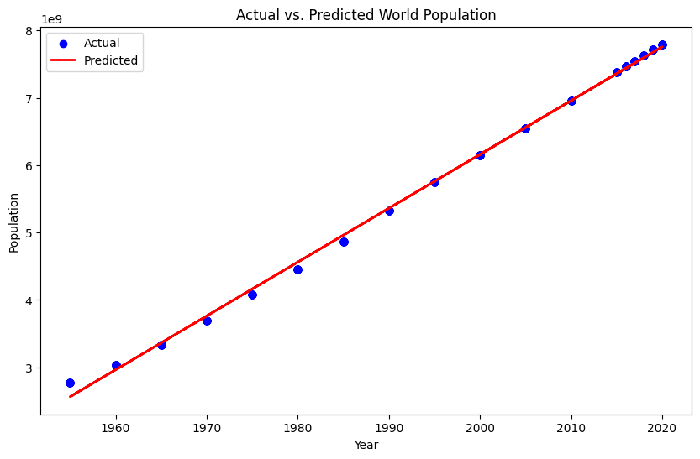
Graphs:
Linear Regression:

Slide 10
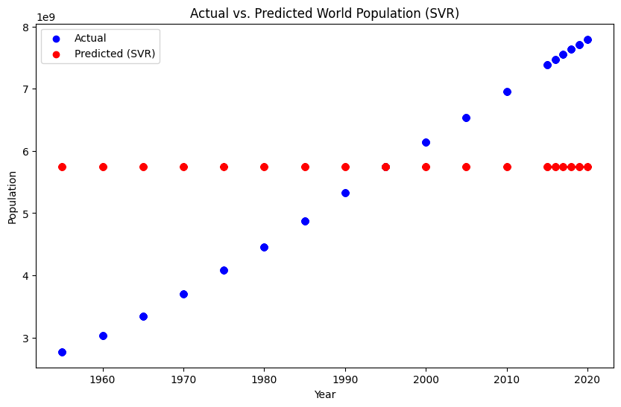
Support Vector Machine(SVM):

Slide 11
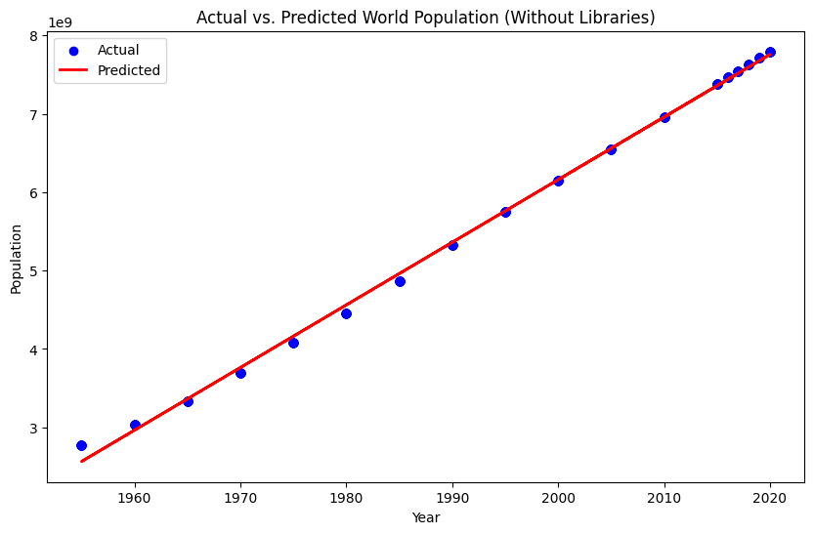
Linear Regression (Manual):

Slide 12
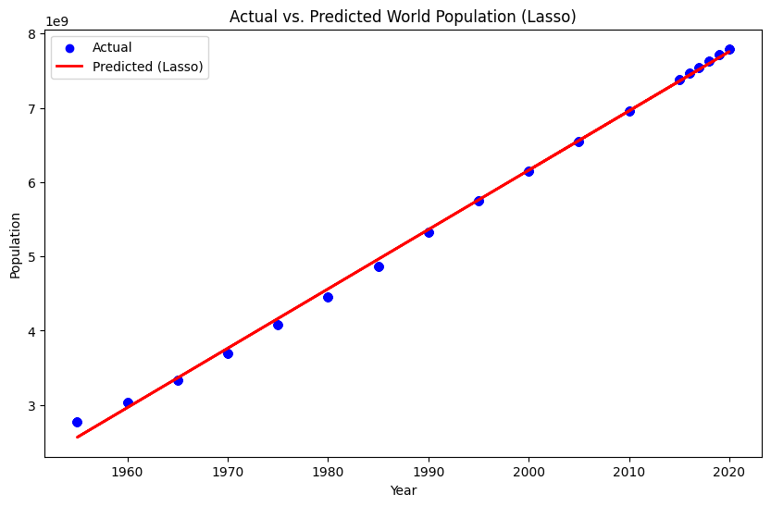
Lasso Regression:

Slide 13
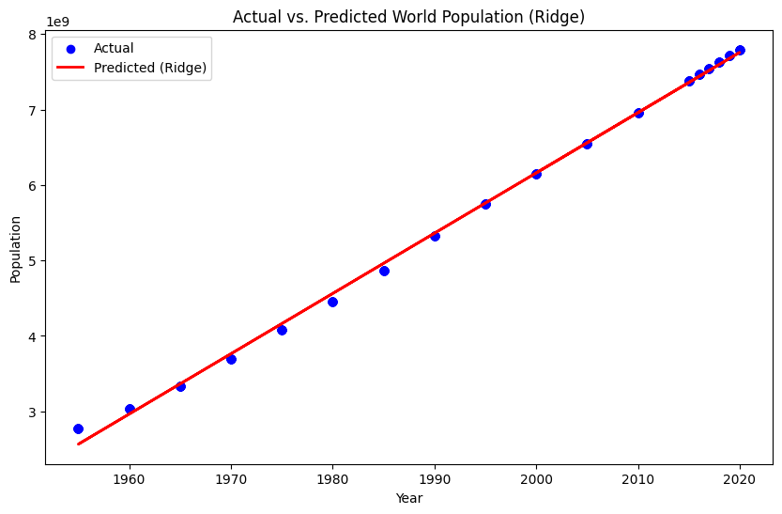
Ridge Regression:

Slide 14
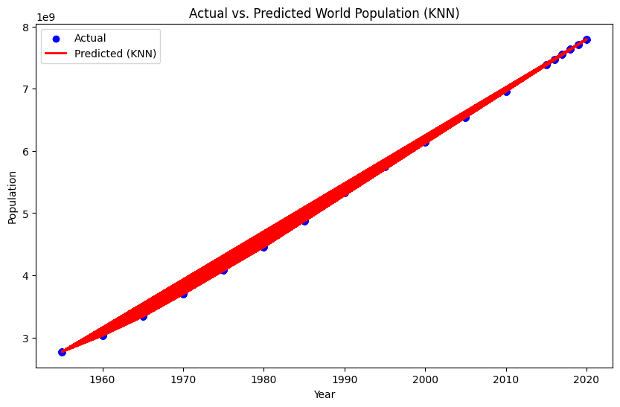
K-Nearest Neighbour:

Slide 15
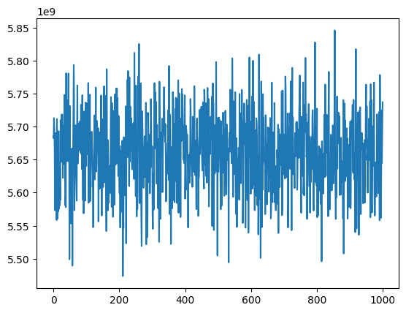
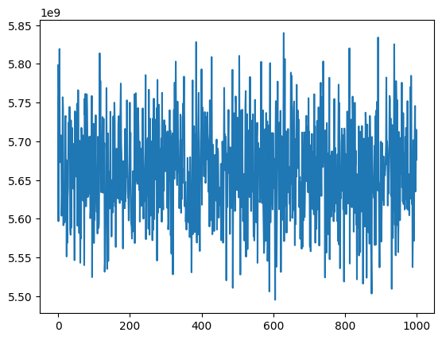
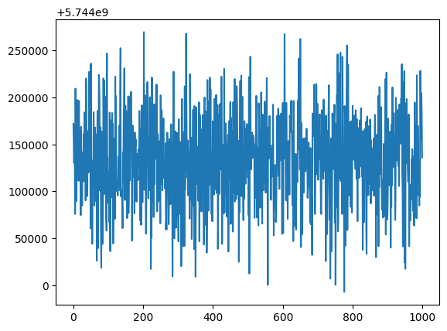
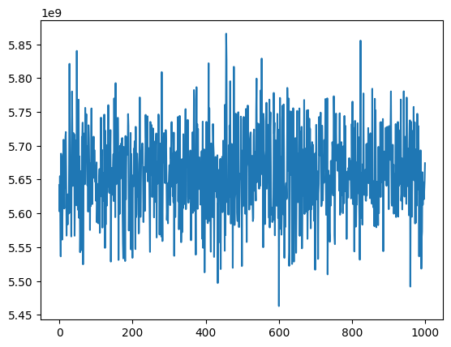
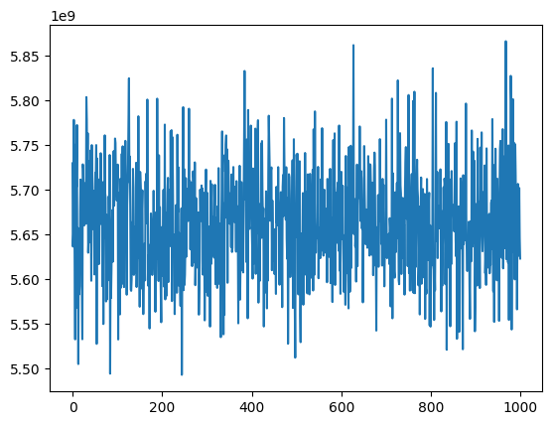
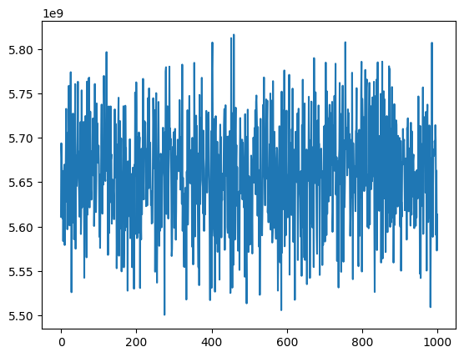
Bootstrapping results:
Linear regression:
Lasso regression:
Support vector machine:
Ridge regression:
Linear regression(manual):
K-Nearest Neighbour:

Slide 16

Results
Linear Regression:
Mean Squared Error (MSE): 4782841856210144.0
Mean Absolute Error (MAE): 50049360.43362623
Support Vector Machine(SVM):
Mean Squared Error (MSE):2.97118330087303e+18
Mean Absolute Error (MAE): 1515417134.7811904
Linear Regression (Without Library):
Mean Squared Error (MSE): 4782841856210081.0
Mean Absolute Error (MAE): 50049360.433631495
Lasso Regression:
Mean Squared Error (MSE): 4782841855787680.0
Mean Absolute Error (MAE): 50049360.44660361
Ridge Regression:
Mean Squared Error (MSE): 4782831815589449.0
Mean Absolute Error (MAE): 50049669.46066117
K-Nearest Neighbors (KNN):
Mean Squared Error (MSE): 0.0
Mean Absolute Error (MAE): 0.0

Slide 17

Limitations:
from above results we can clearly see that MSE and MAE are very large , infact the dataset that is provided for world population contains very large values and since large errors occur then obviously the error will become large. But if we observe the graph we can say that the model is performing good when Linear regression is applied .
even though the model is good fit as observed through graph it can be improved by various other machine learning algorithms and techniques which are advanced make error less and model more accurate for the prediction.
it is observed that even if we apply some advanced machine learning algorithms such as Lasso,Ridge Redgressions and KNN those models are also showing output either similarly as earlier models or inappropriate result.

Slide 18
Conclusion
So, overall what we can conclude is that the Linear regression method is working fine with the dataset provided as compared to Support vector machine
since the error is less in the Linear regression (MSE:4782841856210144.0) process as compared to SVM (MSE:2.97118330087303e+18).
we can also observe that the result of the Linear regression ,Lasso regression and ridge regression is almost same and we can also observe that the result of KNN is 0.0 , it shows that the model is not suitable for data provided so we have to either change data by pre-proccessing it more and analysing it more or we have to move on with other models .
so that we can conclude that from all those algorithms used the performance was better with any kind of simple linear regression model as compared to SVM or KNN.

Slide 19
Thanks!

